Slide 1
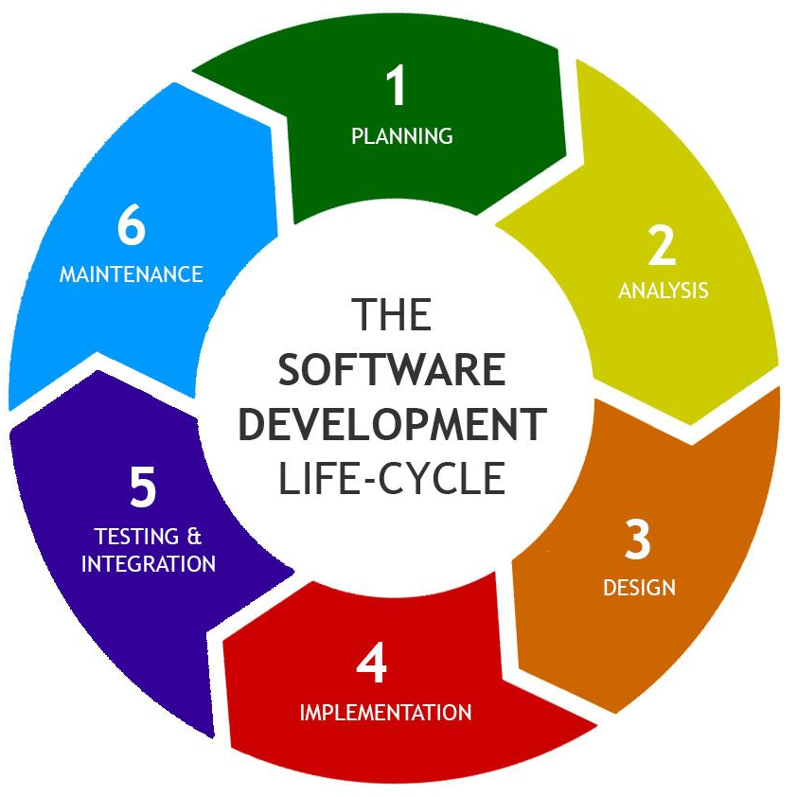
SOFTWARE
DEVELOPMENT
LIFECYCLE

Slide 2
AGENDA
01
Introduction
02
Overview of SDLC Models
03
04
What is SDLC?
Different types of SDLC models and their use
References
Our Team
Meet the team behind this
05
Quiz
Winner will get a Gift Card

Slide 3
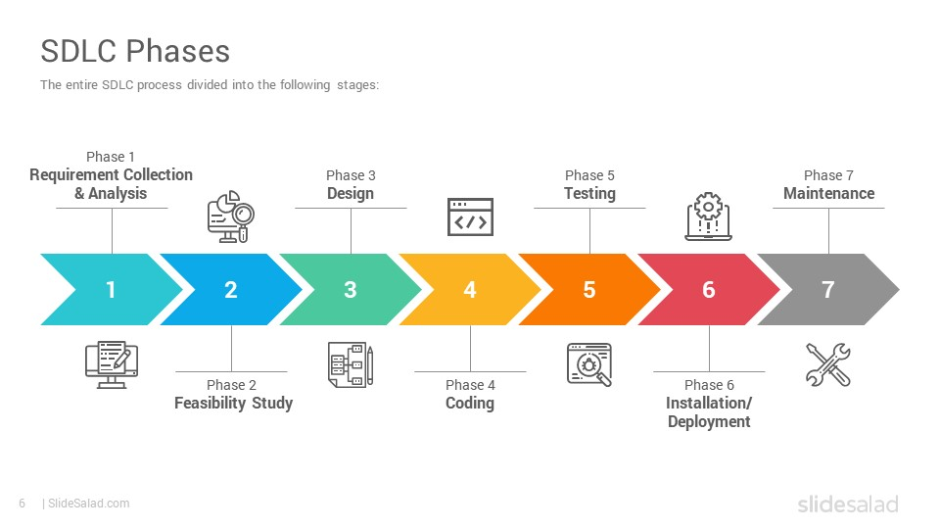
INTRODUCTION
01
What is SDLC?
It is a process followed for a software project
Consists of a detailed plan describing how to develop, maintain, replace and enhance specific software.
SDLC defines a methodology for improving the quality of software and the overall development process. There are seven stages:
Planning
Requirement Analysis
Design
Implementation
Testing
Deployment
Maintenance

Slide 4
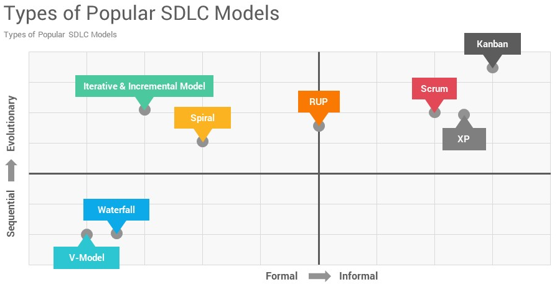
OVERVIEW OF SDLC MODELS
02
Different types of SDLC models and their use
Waterfall
V-Model
Agile Methodologies
Incremental Development Prototyping RAD (Rapid Application Development)
Extreme Programming (XP)
Rational Unified Process (RUP)
Model Driven Architecture (MDA)

Slide 5
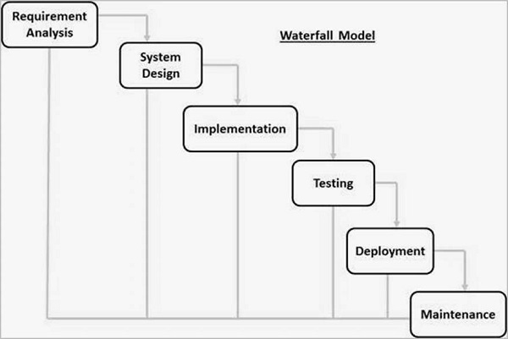
Waterfall Model
02
Different types of SDLC models and their use

Slide 6
The Waterfall Model was the first Process Model to be introduced. Also referred to as a linear-sequential life cycle model. Each phase must be completed before the next phase can begin and there is no overlapping in the phases. Advantages Disadvantages
02
Different types of SDLC models and their use
Simple and easy to understand and use
Easy to manage due to the rigidity of the model.
Each phase has specific deliverables and a review process.
Phases are processed and completed one at a time.
Works well for smaller projects where requirements are very well understood.
Process and results are well documented.
No working software is produced until late during the life cycle.
High amounts of risk and uncertainty.
Not a good model for complex and object-oriented and long projects.
It is difficult to measure progress within stages.
Cannot accommodate changing requirements.
Integration is done as a "big-bang. at the very end, which doesn't allow identifying any technological or business bottleneck or challenges early.

Slide 7
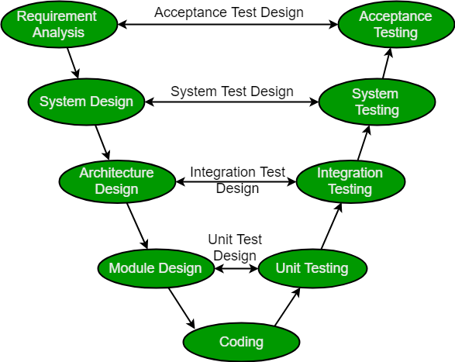
V-Model
02
Different types of SDLC models and their use
Developer’s Life Cycle
Tester’s Life Cycle
Verification Phases
Validation Phases

Slide 8
When to use?
02
Different types of SDLC models and their use
The V-shaped model should be used for small to medium-sized projects Where requirements are clearly defined and fixed.
The V-Model is used when ample technical resources are available with technical expertise.
Advantages:
Disadvantages:
High risk and uncertainty.
It is not a good for complex and object-oriented projects.
It is not suitable for projects where requirements are not clear and contains high risk of changing.
This model does not support iteration of phases.
It does not easily handle concurrent events.
Disciplined model and Phases are completed one at a time.
Used for small projects where project requirements are clear.
Simple and easy to understand and use.
This model focuses on verification and validation activities.
Enables project management to track progress accurately.

Slide 9
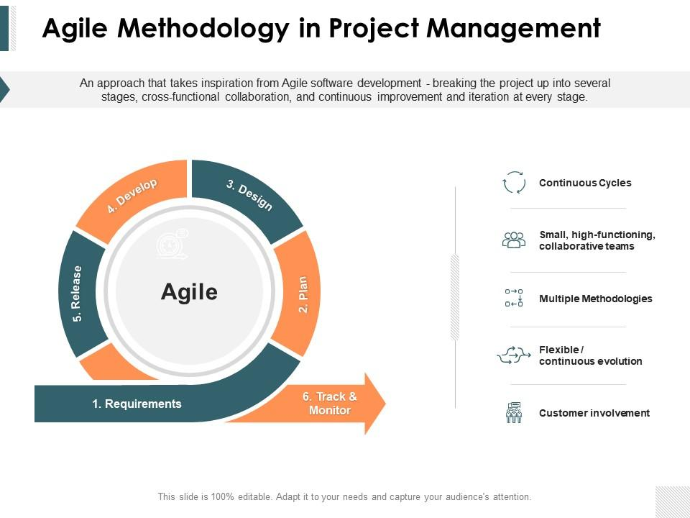
Agile Methodologies
02
Different types of SDLC models and their use

Slide 10
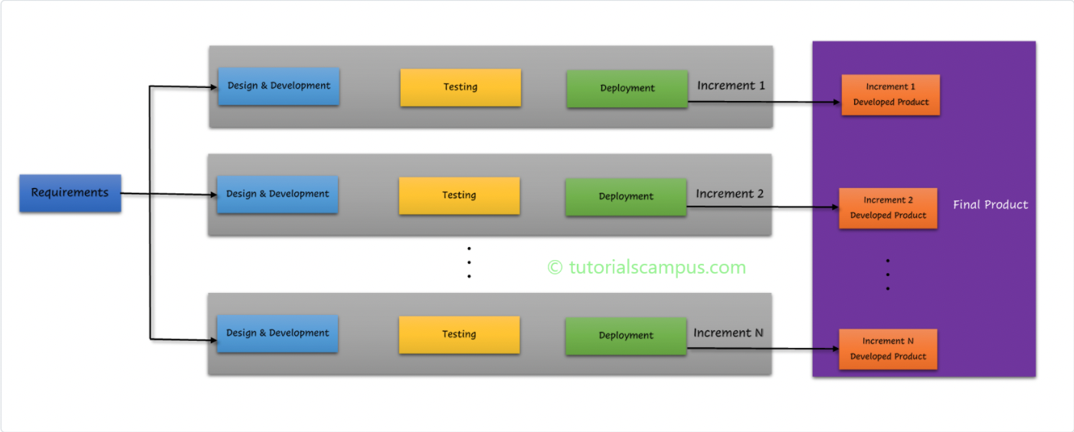
Incremental Model
Different types of SDLC models and their use
Module by module increment
Each module is developed individually and for every new module new functionalities are introduced.
Requirement gathering is first and required step
Maximum customer interaction
Efficient team management.
Overall cost is high
02

Slide 11
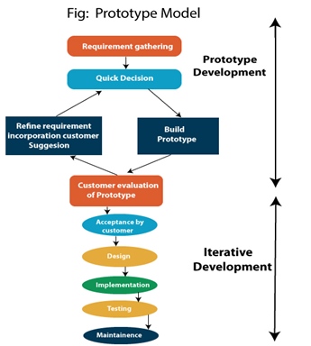
Prototyping
02
Different types of SDLC models and their use
Begins before development is underway
Can be a quick sketch on a whiteboard or a fully interactive mockup
Test partial functionalities with actual users
Type of Prototype – Paper, Wireframe, Visual Design, Code
Advantages:
Reduce the risk of incorrect user requirement, Good where requirement are changing, Reduce Maintenance cost,
Disadvantages:
Costs customer money, Needs committed customer, Difficult to finish if customer withdraw, Difficult to estimate project completion

Slide 12
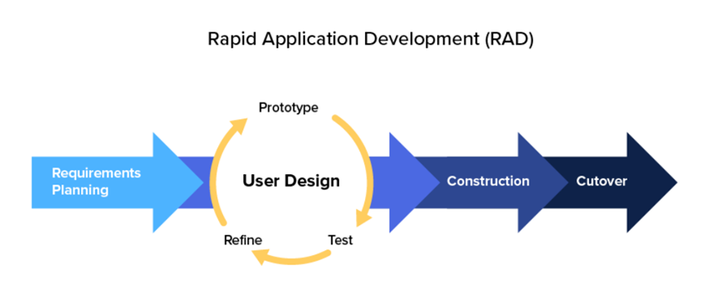
RAD (Rapid Application Development)
02
Different types of SDLC models and their use
RAD is a development model that prioritizes rapid prototyping and quick feedback over long-drawn-out development and testing cycles.
Steps in Rapid Application Development
Define the requirements
Prototype
Receive Feedback
Finalize Software
Benefits of RAD
Development time is drastically reduced
Requirements can be changed at any time
Reviews are quick
More productivity with fewer people

Slide 13
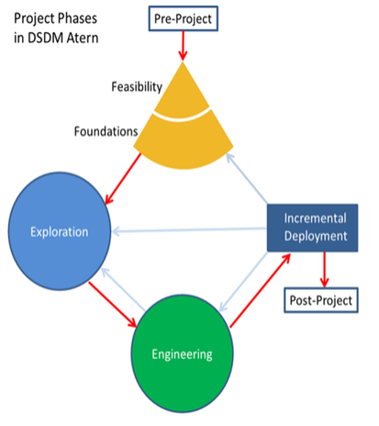
DSDM Framework
02
Different types of SDLC models and their use
DSDM is based upon the rapid application development (RAD) method. It was originally developed to provide more discipline to the RAD method
Phases of DSDM
Feasibility and business study
Functional model / prototype iteration
Design and build iteration
Implementation

Slide 14
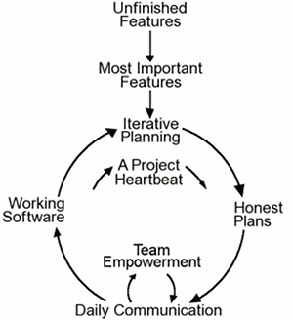
Extreme Programming (XP)
02
Different types of SDLC models and their use
Its about good practices taken to an extreme
Empowers developers to respond to customer requirements
Emphasizes teamwork
Focuses on customer satisfaction
Utilizes Pair Programming
Avoids long-lasting planning, implementation, testing phases

Slide 15
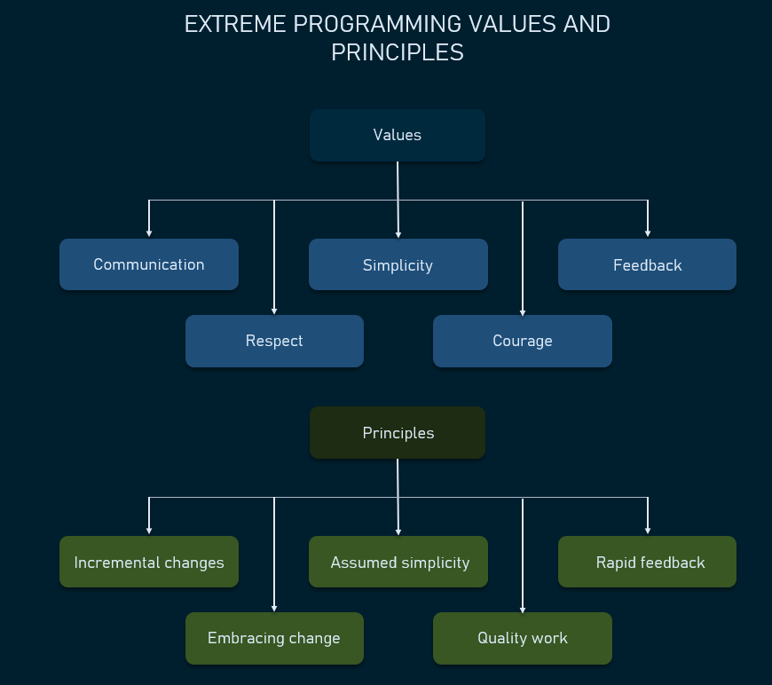
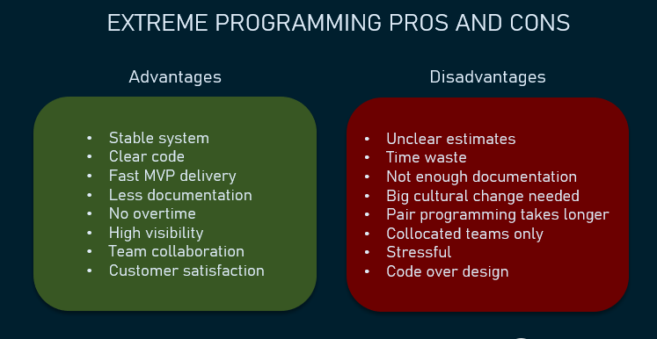
Extreme Programming (XP)
02
Different types of SDLC models and their use
XP follows certain Values and Principles
Used in highly-adaptive development, small teams and customer participation scenario

Slide 16
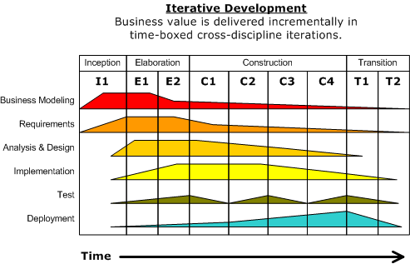
RUP (Rational Unified Process)
02
Different types of SDLC models and their use
History : RUP ( Rational Unified Process) It is an iterative software development process framework created by the Rational Software Corporation, a division of IBM since 2003.
It has mainly 4 project life cycle phases
Inception
Elaboration
Construction
Transition
These life cycle phases involves 6 engineering disciplines: Business Modeling, Requirements, Analysis & Design, Implementation, Test and Deployment

Slide 17
RUP (Rational Unified Process)
02
Different types of SDLC models and their use
Pros :
It is proactively able to resolve the project risks associated with the client’s evolving requirements requiring careful change request management
Less time is required for integration as the process of integration goes on throughout the software development life cycle
The development time required is less due to reuse of components
Cons :
The team members need to be expert in there field to develop a software under this methodology
The development process is too complex and disorganized
On cutting edge projects which utilizes new technology, the reuse of components will not be possible. Hence the time savings one could have made will be impossible to fulfill

Slide 18
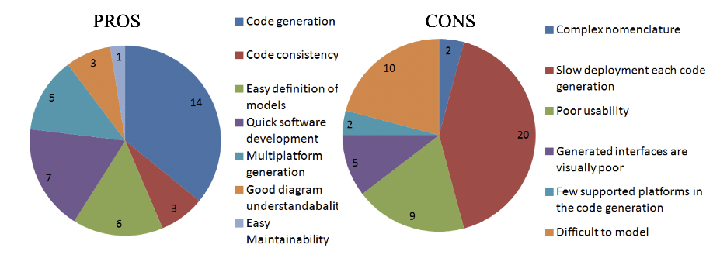
Model Driven Architecture
02
Different types of SDLC models and their use
Model Driven Architecture provides an approach for deriving value from models and architecture in support of the full life cycle of physical, organizational and I.T. systems"
A model is a (representation of) an abstraction of a system
MDA® provides value by producing models at varying levels of abstraction, from a conceptual view down to
the smallest implementation detail
It describes an approach to separating business-level functionality from the technical nuances of its implementation

Slide 19
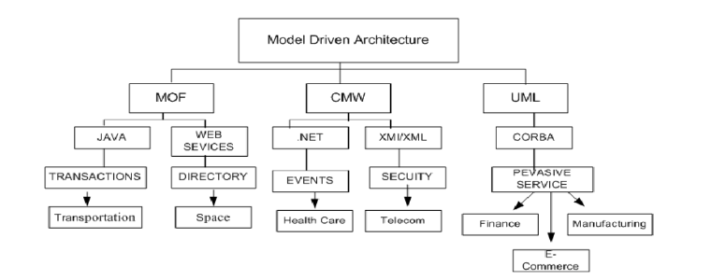
02
Different types of SDLC models and their use
Model Driven Architecture

Slide 20
REFERENCES
03
References
https://www.atlassian.com/blog/agile/agile-design-prototype
https://www.javatpoint.com/software-engineering-v-model
https://www.tutorialspoint.com/sdlc/sdlc_v_model.htm
https://kissflow.com/low-code/rad/rapid-application-development/ https://www.strategic.tech/dsdm-rad https://www.tutorialspoint.com/sdlc/sdlc_waterfall_model.htm https://www.altexsoft.com/blog/business/extreme-programming-values-principles-and-practices/

Slide 21
OUR TEAM
04
Our Team
Gopala Krishna Hemanth Erukulla
Kavya Sri Garikipati
Omkar Gawade
Pruthvik Kakadiya
Samyak Jain
Shivani Goyani
Surabhi Ingole
Tharun Sai Ghattamaneni

Slide 22



Please add your full name in the nickname box.
You will have time limit to answer the question.
Answer cannot be changed once selected.
Gift Card for the one who will be leading the quiz....!

Slide 23
THANK YOU
Q&A

